Slide 1
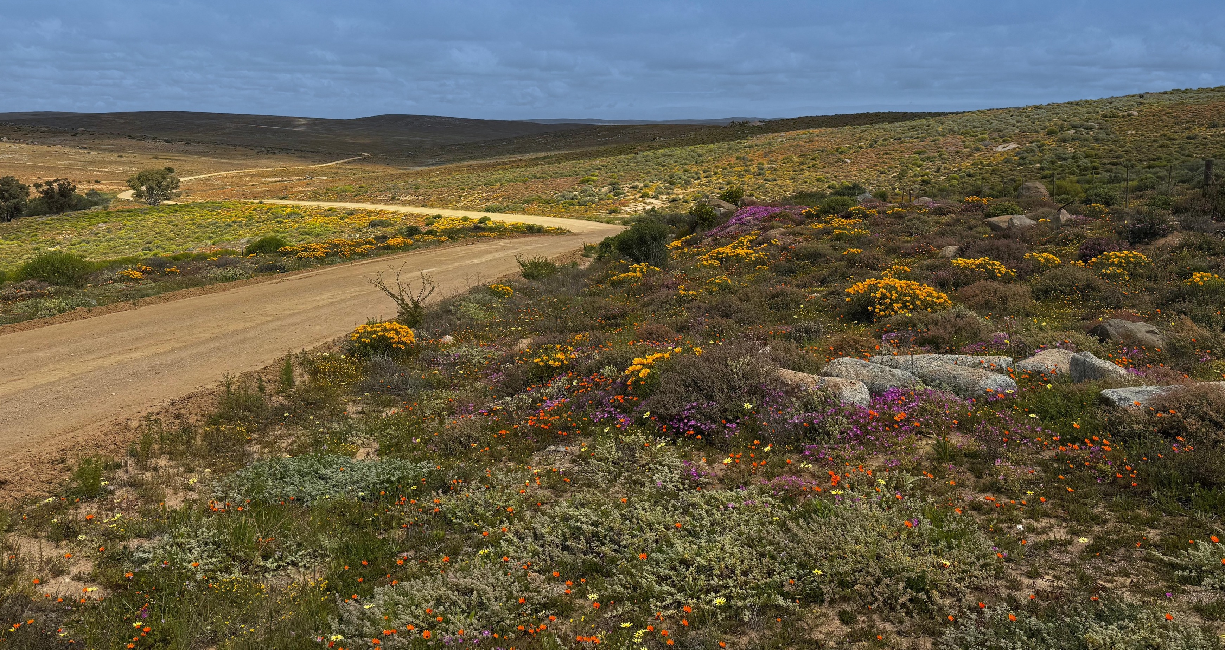
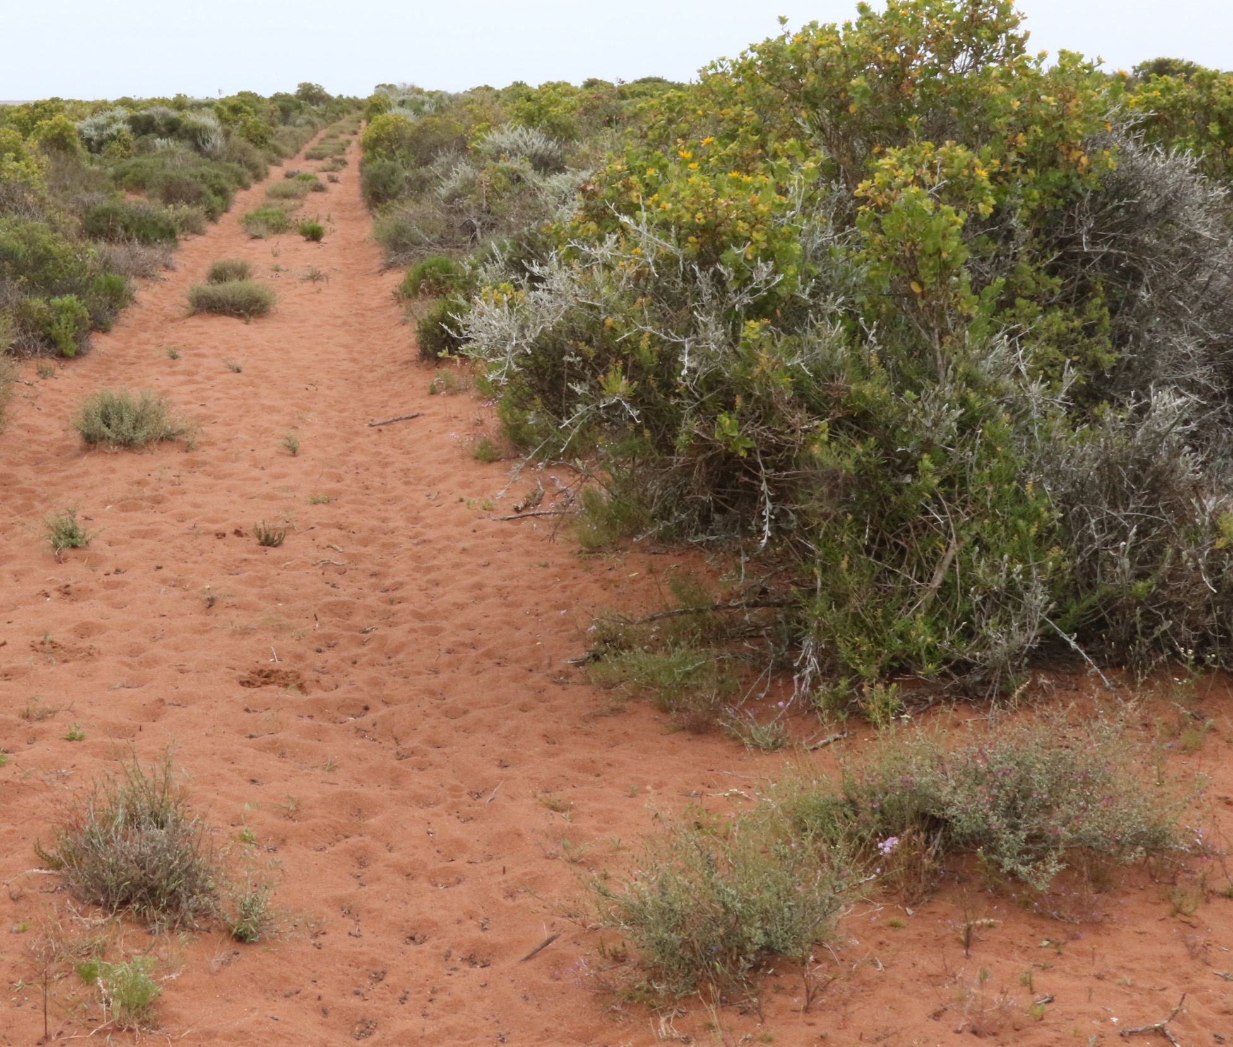
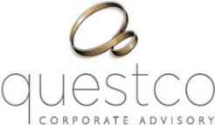
Opportunity to acquire a world-class,
ZIRCON MINERAL
SANDS RESOURCE
A first-quartile mineral sands project, underpinned by a high-value mineral assemblage, located within an established mineral sands province with excellent infrastructure.
October 2026

Slide 2
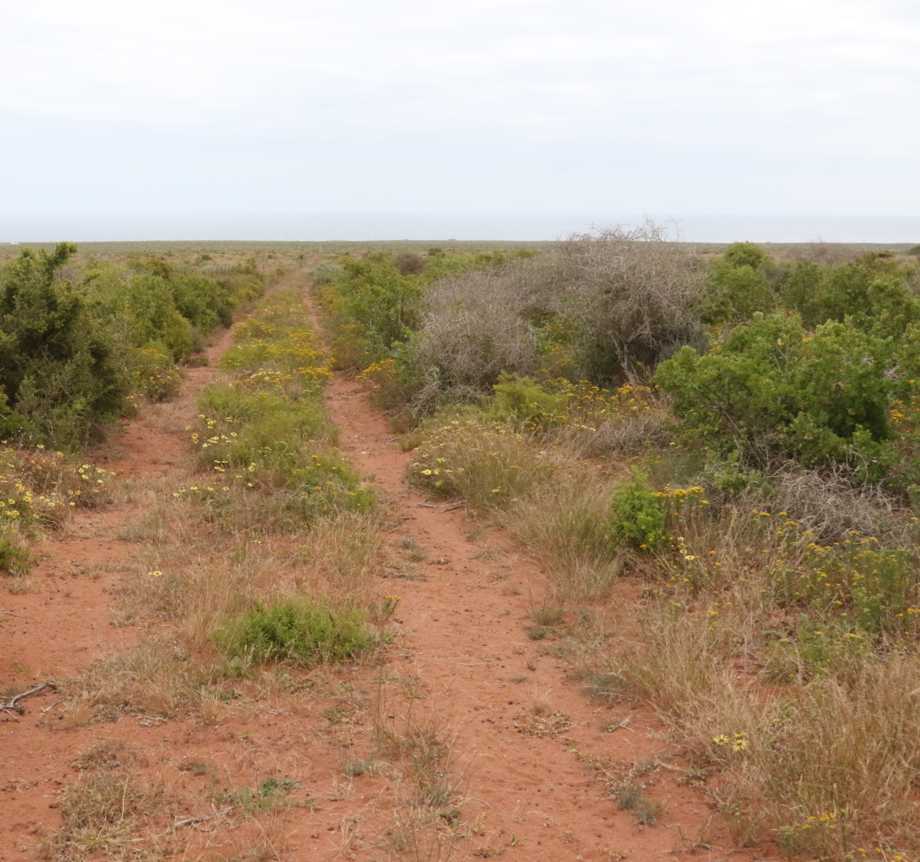
THE OPPORTUNITY
Opportunity to acquire a controlling interest (up to 100%) in Buchuberg Resources Pty Ltd, holder of the Cape Zircon Project located in the district of Vredendal (Western Cape Province of South Africa).
Shareholder Consortium
100%
The Preliminary Economic Assessment (PEA) of the Cape Zircon project confirms a highly profitable, large-scale operation with the potential to deliver significant economic benefits — driving job creation and regional growth along South Africa’s West Coast.
Buchuberg Resources Pty Ltd
Prospecting rights secured and valid until November 2028 with an automatic renewal until November 2031.
Initial environmental assessment has been completed.
Mining right application to be submitted in 2027.
Prospecting Right
CAPE ZIRCON A world-class discovery…
page 2

Slide 3
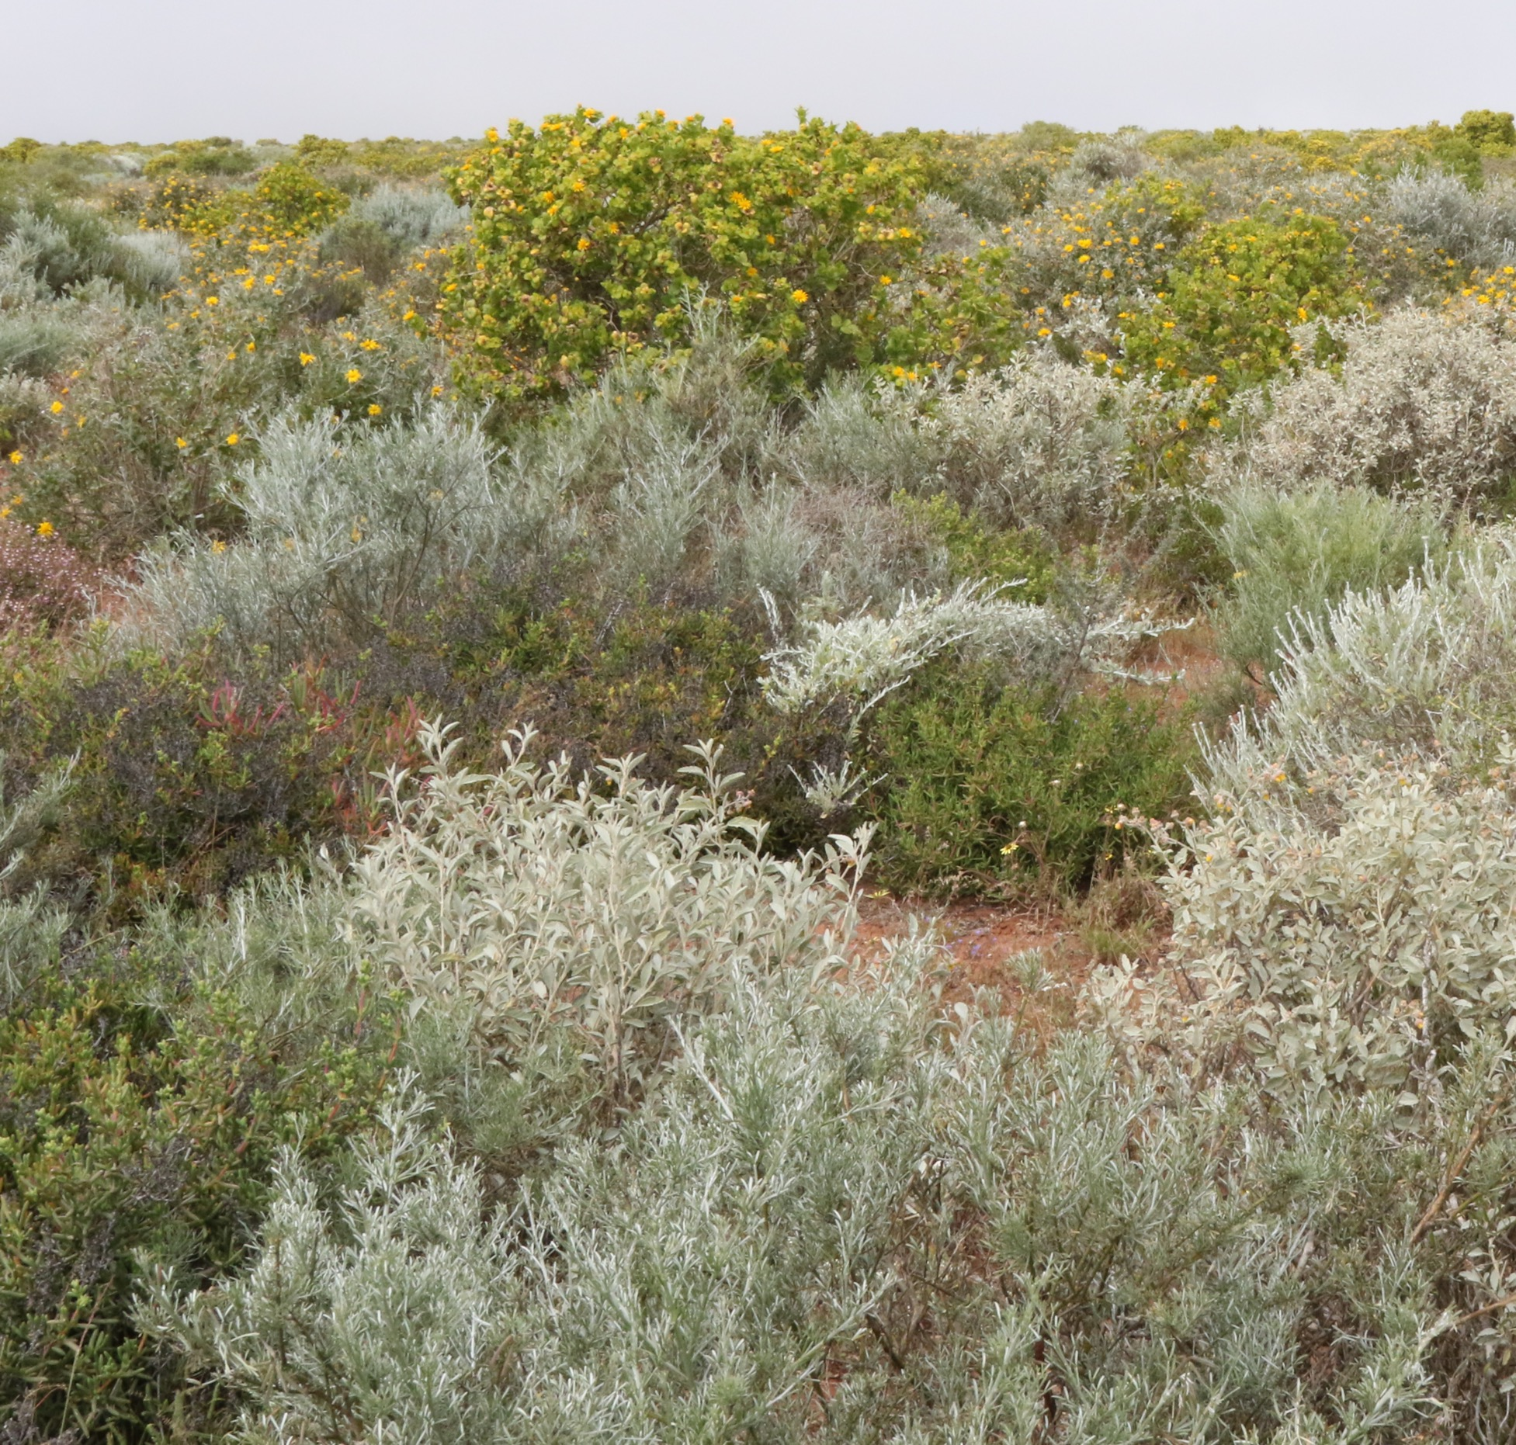
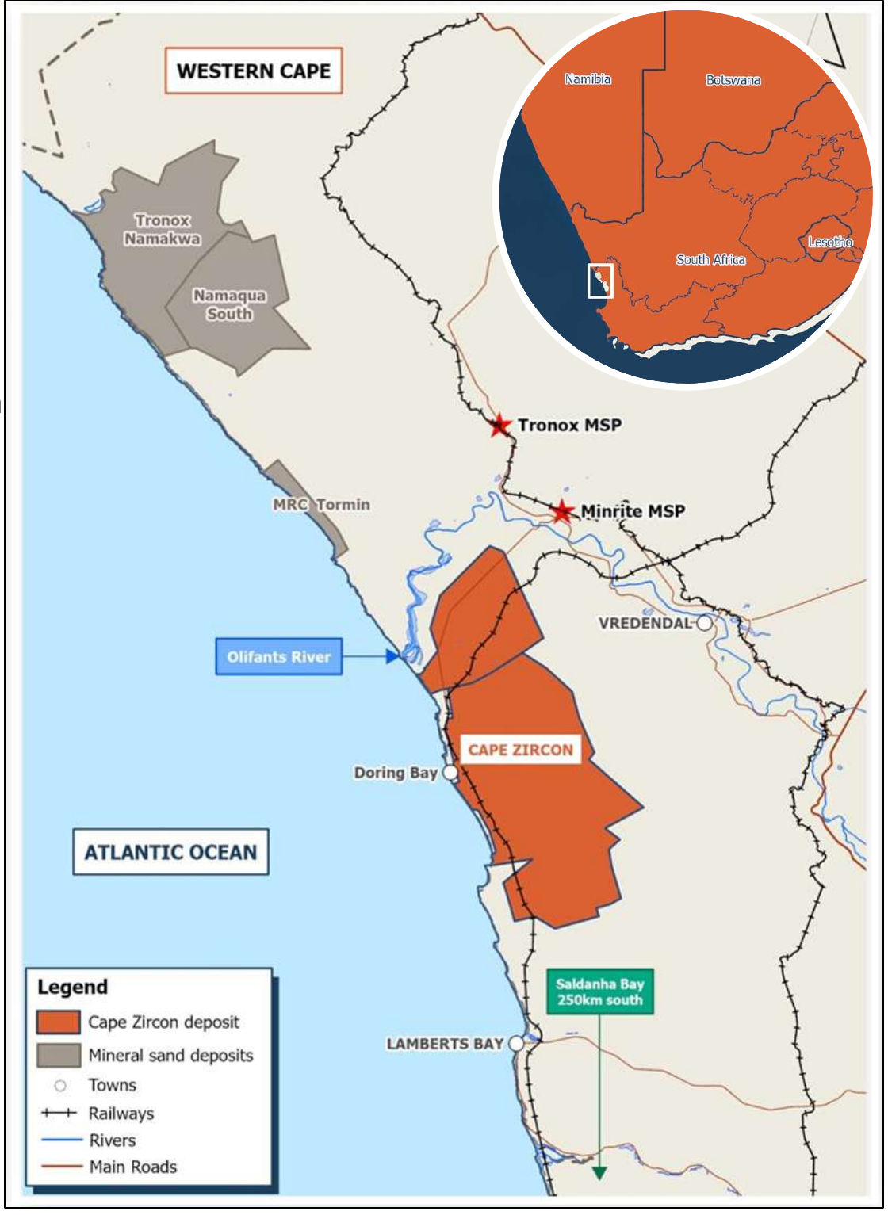

PRELIMINARY ECONOMIC ASSESSMENT (PEA) RESOURCES & LIFE OF MINE
Tier 1 Resource supporting a
27-year mine life
and creating over 500 direct jobs
PEA based on a JORC resource of 1.2 billion tonnes at 3.3% Total Heavy Minerals (THM) with associated high grade zircon.
Contained Zircon = 3.8 million tonnes
Contained Rutile = 2.9 million tonnes
Highly attractive product suite - Zircon and rutile combined constitute 77% of annual revenue.
Low-tech mining, no pre-strip of overburden.
Standard industry processing flowsheet and mineral recoveries.
ORE MINED
16.2 Mtpa
ANNUAL PRODUCTION
  382 ktpa HMC
  253 ktpa mag-cons
  (crude sulfate ilmenite)
  129 ktpa non-mag concentrate
MINING RATE
2150 tonnes
per hour
CAPE ZIRCON A world-class discovery…
page 3
2

Slide 4
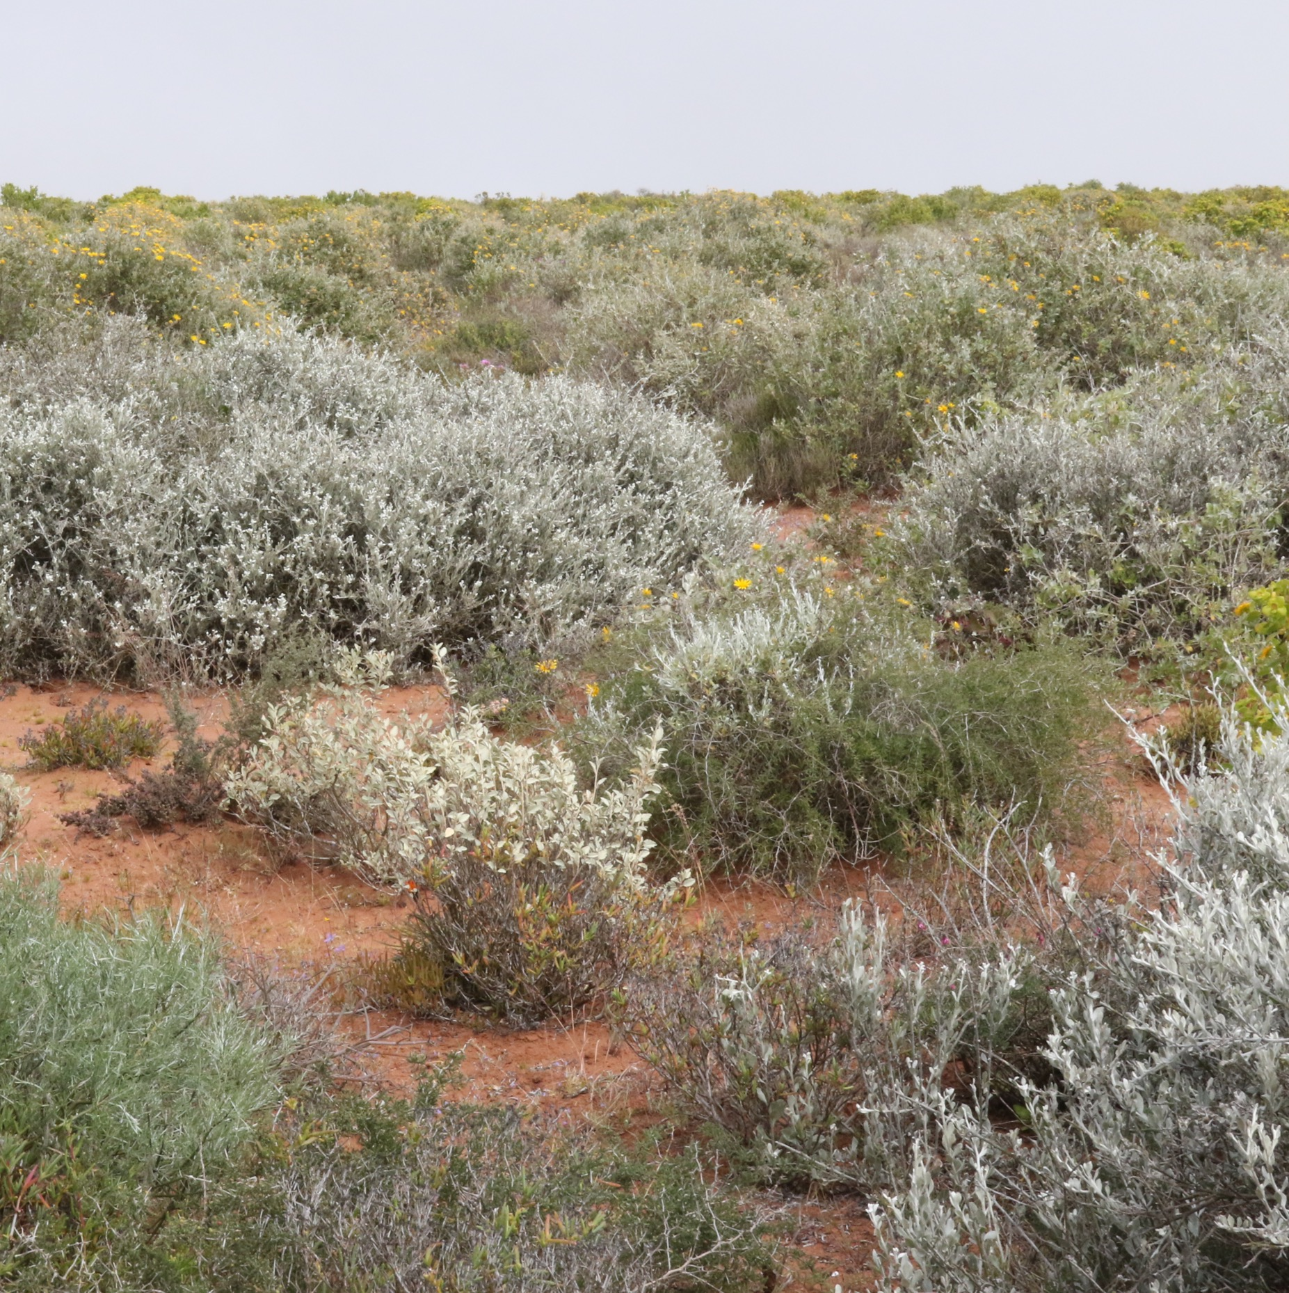






PRELIMINARY ECONOMIC ASSESSMENT (PEA) FINANCIAL HIGHLIGHTS
CAPEX
US$194 million*
ANNUAL REVENUE
US$180 million
EBITDA
US$85.5 million pa
OPERATING COSTS
US$5.29/tonne
ROM mining cost
US$224 per tonne
of final product
1st Quartile of Global Revenue / Cost Curve
PRE-TAX 8% REAL NPV
US$766 million
IRR
51%
*Simple dry mining (contractor) at surface with no overburden. Standard industry flowsheet via a PCP and SCP to produce mags and non-mags concentrates.
page 3
CAPE ZIRCON A world-class discovery…
page 4

Slide 5
PRE-FEASIBILITY – RESOURCE STATEMENT
JORC Compliant Mineral Resource Estimate (cut-off grade 1.5% THM), October 2026
Classification | Domain | Tonnes (Mt) | THM % | Ilmenite % | Rutile % | Zircon % | Monazite %
Measured | RAS | 22.2 | 4.05 | 1.76 | 0.57 | 0.65 | 0.013
 | OFS HZ | 252.4 | 3.34 | 1.26 | 0.39 | 0.39 | 0.010
 | OFS LZ | 50.0 | 2.81 | 1.01 | 0.13 | 0.14 | 0.006
 | Sub-total | 324.6 | 3.31 | 1.25 | 0.36 | 0.37 | 0.010
Indicated | RAS | 135.4 | 3.12 | 1.39 | 0.45 | 0.47 | 0.010
 | OFS HZ | 162.7 | 2.91 | 1.05 | 0.33 | 0.42 | 0.009
 | OFS LZ | 35.2 | 2.85 | 1.11 | 0.14 | 0.16 | 0.006
 | STRL | 29.9 | 13.69 | 4.56 | 0.41 | 0.59 | 0.015
 | Sub-total | 363.2 | 3.87 | 1.47 | 0.36 | 0.43 | 0.010
Inferred | RAS | 16.7 | 2.81 | 1.26 | 0.41 | 0.44 | 0.009
 | OFS HZ | 154.5 | 3.00 | 1.19 | 0.37 | 0.45 | 0.009
 | OFS LZ | 42.4 | 2.51 | 0.90 | 0.12 | 0.13 | 0.006
 | Sub-total | 213.5 | 2.89 | 1.14 | 0.32 | 0.39 | 0.009
Grand total |  | 901.4 | 3.44 | 1.31 | 0.35 | 0.40 | 0.010
Contained (Mt) | Ilmenite | Rutile | Zircon | Monazite
Measured | 4.06 | 1.17 | 1.20 | 0.03
Indicated | 5.34 | 1.31 | 1.56 | 0.04
Inferred | 2.43 | 0.68 | 0.83 | 0.02
Total | 11.83 | 3.16 | 3.60 | 0.09
Notes:
RAS – Red Aeolian Sands
OFS HZ – Orange Feldspathic Sands High Zircon
OFS LZ – Orange Feldspathic Sands Low Zircon
STRL – Strandline
Totals may not add due to rounding
CAPE ZIRCON A world-class discovery…
page 5

Slide 6
PRE-FEASIBILITY – GEOLOGY & PROGRESS
Multi-faceted mineral sands orebody
Exceptional mineral assemblage in RAS with 30% Zircon + Rutile in assemblage
OFS HZ mineralisation up to 25m thick in west and wedges out to the east at roughly 2 km (23% Zircon + Rutile in assemblage)
OFS LZ mineralisation up to 50m thick and open to the east
High grade strandlines well developed at 40m elevation, current drill spacing not adequate to delineate strandlines fully
Deposit remains open to north, close to Olifants River sediment feeder
Pre-Feasibility Study (PFS) work programme
PFS work is continuing, with the mining study underway
Metallurgical bulk samples to be submitted for testwork shortly
PFS completion targeted for end March 2027
CAPE ZIRCON A world-class discovery…
page 6

Slide 7



CONTACT
All communication regarding Cape Zircon must be directed solely to Questco Proprietary Limited (Questco), acting as Corporate Advisor to Buchuberg Resources Pty Ltd and its Shareholders in relation to the Cape Zircon project.
NICK STEVENSON
nick.stevenson@questco.co.za
+27 83 262 3578
CISKA KLOPPERS
ciska.kloppers@questco.co.za
+27 82 303 4826
Confidentiality and Disclaimer
This document has been prepared to provide information on Cape Zircon named herein.
This document may not be copied, disclosed, published or distributed to any other person without the prior written consent of Buchuberg Resources or Questco, save to directors, officers, shareholders, employees and professional advisors required to assist the direct recipient of this document (“Recipient”) in forming an investment view.
This document and the material contained in this document is not and does not constitute an offer, invitation or recommendation to purchase any business of or subscribe for, or purchase, any shares in any party named herein, nor does it form the basis of any contract or commitment by any of the parties named herein to enter into any agreement with the Recipient.
This document does not purport to contain all the information that the Recipient may require, nor is it intended to replace any form of legal, financial or technical due diligence. There is no obligation on any party to update this document in the event of any change in circumstances.
Statements contained in this document may constitute forward looking statements. Such statements relate to future events and expectations and, as such, involve known and unknown risks and uncertainties. Actual results and developments may differ materially from those expressed or implied by these forward-looking statements depending on a variety of factors. Neither Buchuberg Resources, Questco, nor any other party noted in this document, or any of such parties’ directors, officers, shareholders, employees, customers, agents, contractors, attorneys and/or other professional advisors shall have any liability of whatsoever nature, including liability to any person by reason of negligence, negligent misstatement, gross negligence or grossly negligent misstatement, and no Recipient shall have any claim whatsoever, for any statements, opinions, information or matters, express or implied, arising out of, contained in or derived from, or for any omissions from, this material.
page 3
CAPE ZIRCON A world-class discovery…
page 7
Under no circumstances may the directors, shareholders, employees or affiliates of Buchuberg Resources be contacted directly without pre-approval from Questco

